Slide 1
Lifestyle-Based Cervical Cancer Risk Prediction and Population Burden Analysis in West Africa
OPEOLUWA G. OMONIYI
M.Sc. Data Science Student
University of Hertfordshire
1

Slide 2
introduction
This project applies data science methods to examine Cervical Cancer from two perspectives:
The first is Individual-level risk prediction using machine learning models trained on behavioural and clinical variables.
The second is population-level analysis using cervical cancer incidence and prevalence data from West African countries.
The purpose of combining these two approaches is to provide both a predictive and a regional understanding of cervical cancer patterns.
2

Slide 3
Motivation
Previous studies have shown that machine learning can be used to predict cervical cancer risk from behavioural and clinical variables. However, most of these studies focus only on model accuracy using a single dataset.
This project goes further by also analysing incidence and prevalence trends in West Africa, linking individual risk prediction with population-level patterns.
“How can lifestyle-based cervical cancer risk prediction models developed from individual-level datasets be used to inform disease burden patterns in West African populations?”
RESEARCH QUESTION

Slide 4
Overview of Previous Work Related to the Project
Al Mudawi and Alazeb (2022) compared several machine learning models for cervical cancer prediction, including Logistic Regression, Decision Tree, and Random Forest, and found that ensemble methods provided more accurate predictions of cervical cancer risk than simpler models.
Uddin et al. (2024) extended this area of research by combining hybrid feature selection with ensemble learning, reporting very high classification accuracy.
Similarly, Kaushik et al. (2022) applied XGBoost for cervical cancer prediction and demonstrated that gradient boosting can achieve strong performance on structured healthcare datasets.
4

Slide 5
What this project will do
Compare Logistic Regression, Random Forest, and XGBoost for cervical cancer risk prediction.
Use behavioural and clinical variables from the UCI Cervical Cancer dataset.
Analyse cervical cancer incidence and prevalence in West Africa using GBD IHME data.
HOW IT COMPARES TO PREVIOUS WORK
Similar to previous studies in using machine learning for cervical cancer prediction.
Different because it also includes population-level incidence and prevalence analysis.
Extends previous work beyond model accuracy to a broader regional perspective.

Slide 6
Dataset description
Cervical Cancer Risk Factors dataset (UCI Machine Learning Repository) – Machine learning analysis 🔬
Key factors: age, smoking, sexual behaviour, contraceptives, STDs
Target variable: Biopsy (confirmed diagnosis)
Type: CSV (tabular data)
Size: 858 records, 36 features
Contains behavioural and clinical risk factors
Link: https://archive.ics.uci.edu/ml/datasets/Cervical+Cancer+(Risk+Factors)
Global Burden of Disease (GBD) 2023 data from the Institute for Health Metrics and Evaluation (IHME) - (Population-Level Analysis)
Covers incidence and prevalence of cervical cancer in West Africa
Includes country, year, age, sex, and rate data
Supports cross-country burden comparison
Data type: CSV (tabular epidemiological data)
Measures used: Cervical cancer incidence and prevalence
Coverage: West African countries across multiple years
Link: https://ghdx.healthdata.org/gbd-results-tool

Slide 7
Ethical implications
The UCI cervical cancer dataset is anonymised, reducing the risk of exposing personal or sensitive information.
The GBD IHME dataset contains aggregated data, meaning no individual-level identifiers are included.
The dataset may introduce bias, as it may not fully represent West African populations, affecting model generalisation.
Machine learning predictions should be used as supportive tools and not as a replacement for clinical decision-making.
Transparency in data processing and model development is essential to ensure reliability and reproducibility of results.

Slide 8
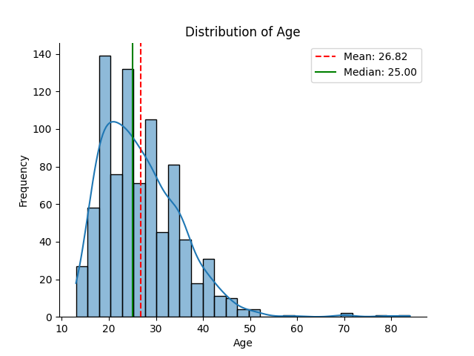
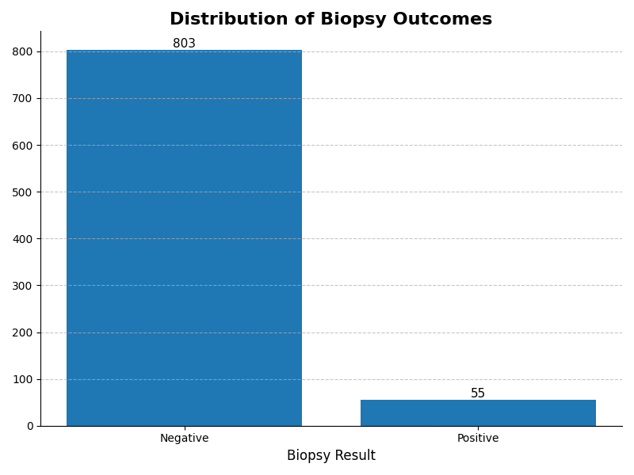
Exploratory Data Analysis
Figure 1: Age distribution plot.
Majority of patients are aged 20–30
Figure 2: Biopsy distribution plot.
Severe class imbalance (803 vs 55).
Random Oversampling was applied to address the significant class imbalance in the dataset, where 803 instances belonged to the negative class and only 55 to the positive class.
This technique increases the representation of the minority class by duplicating existing samples, thereby enabling the model to learn patterns associated with cervical cancer more effectively.

Slide 9
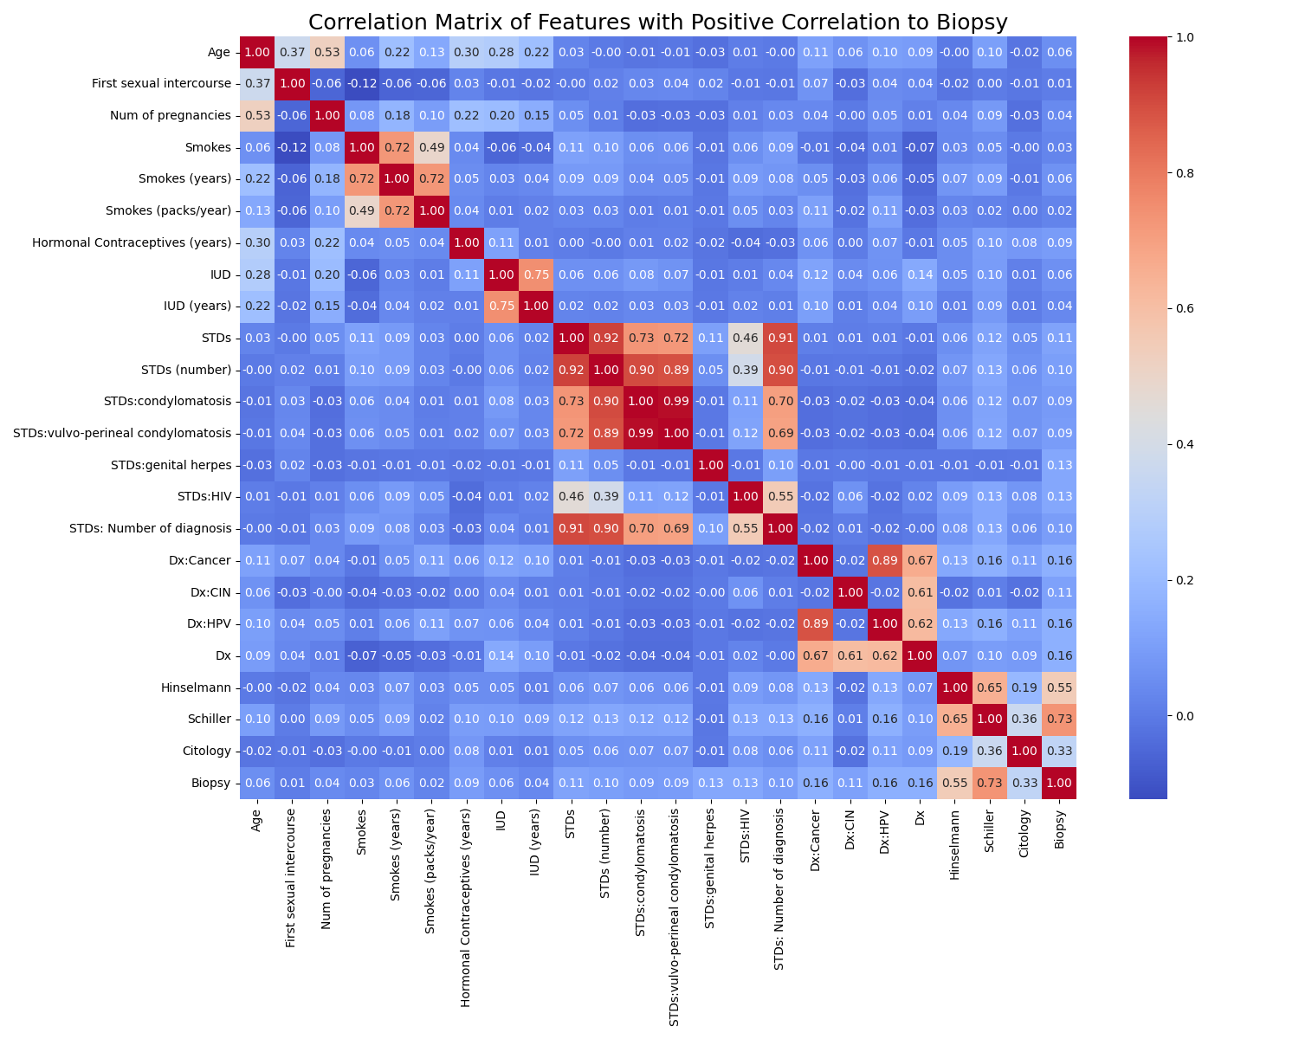
Exploratory Data Analysis
Figure 3: Correlation Matrix of Features with Positive Correlation to Biopsy
Strong correlation: Schiller, Hinselmann → Biopsy
Moderate: HPV, prior diagnosis
Weak: Age, smoking, behavioural factors
9

Slide 10

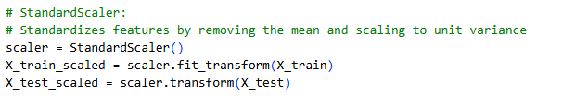


Pre-processing
Missing values handled using median imputation to reduce the impact of outliers.
Feature scaling applied using StandardScaler for model consistency.
Train-test split performed (e.g., 80% training, 20% testing).
Class imbalance addressed using Random Oversampling.

Slide 11


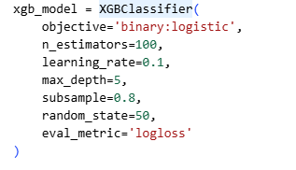
MODELS USED
Logistic Regression
A linear model used for binary classification
Estimates the probability of an outcome using a logistic (sigmoid) function.
Simple, fast, and highly interpretable.
Random Forest
An ensemble method combining multiple decision trees
Uses bagging to reduce overfitting.
Captures non-linear relationships and provides feature importance.
XGBoost
An advanced gradient boosting algorithm.
Builds trees sequentially to correct previous errors.
High performance and handles complex patterns effectively.

Slide 12
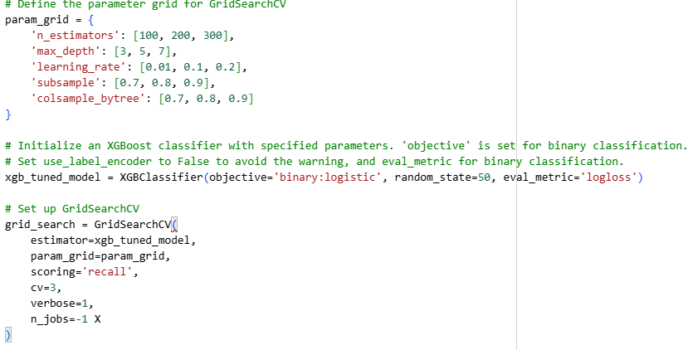
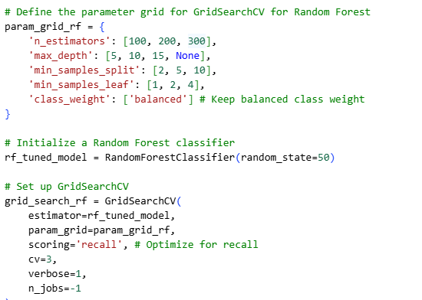
Hyperparameter tuning
GridSearchCV with 3-fold cross-validation was used.
Recall was optimised to improve cancer detection.
XGBoost tuned tree depth, estimators, and learning rate.
Random Forest tuned tree structure and used class weighting.
Outcome: Best models selected based on highest recall, reducing missed cases.

Slide 13
MODEL RESULTS
MODELS | ACCURACY | RECALL(Class 1)
Logistic Regression | 0.78 | 0.27
XGBoost | 0.88 | 0.27
Random Forest | 0.93 | 0.09
Although Random Forest achieves the highest accuracy (0.93), it performs poorly in detecting positive cases, with a recall of only 0.09, indicating that most cervical cancer cases are misclassified.
In contrast, both Logistic Regression and XGBoost achieve higher recall (0.27), making them more suitable for medical screening tasks.
Among these, XGBoost provides the best balance between accuracy and recall, and is therefore the preferred model for cervical cancer prediction.

Slide 14
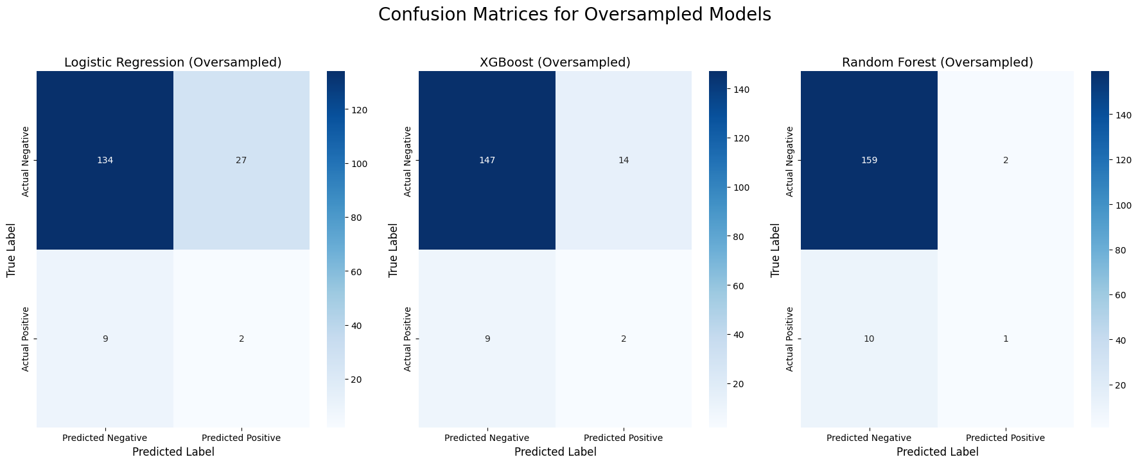
MODELS RESULTS
Logistic Regression
TN: 134 | FP: 27
FN: 9 | TP: 2 Detects some cancer cases but produces a high number of false positives and still misses several cases.
XGBoost
TN: 147 | FP: 14
FN: 9 | TP: 2 Provides a better balance, reducing false positives while maintaining the same level of cancer detection.
Random Forest
TN: 159 | FP: 2
FN: 10 | TP: 1 Very low false positives but misses most cancer cases, indicating poor detection performance.

Slide 15
EVALUATION AND FUTURE WORK
The results show good accuracy (up to 93%), but overall performance is limited by low recall.
50% accuracy is not acceptable, and while 80%+ is better, accuracy alone is not sufficient for this task.
For cervical cancer prediction, high recall is more important to minimise missed cases.
PLANS FOR IMPROVEMENT
Improve recall through threshold adjustment and further tuning.
Apply additional models (e.g., SVM, Neural Networks, ensemble methods).
Enhance data quality and explore more relevant features.
Evaluate additional metrics such as FPR and precision.

Slide 16
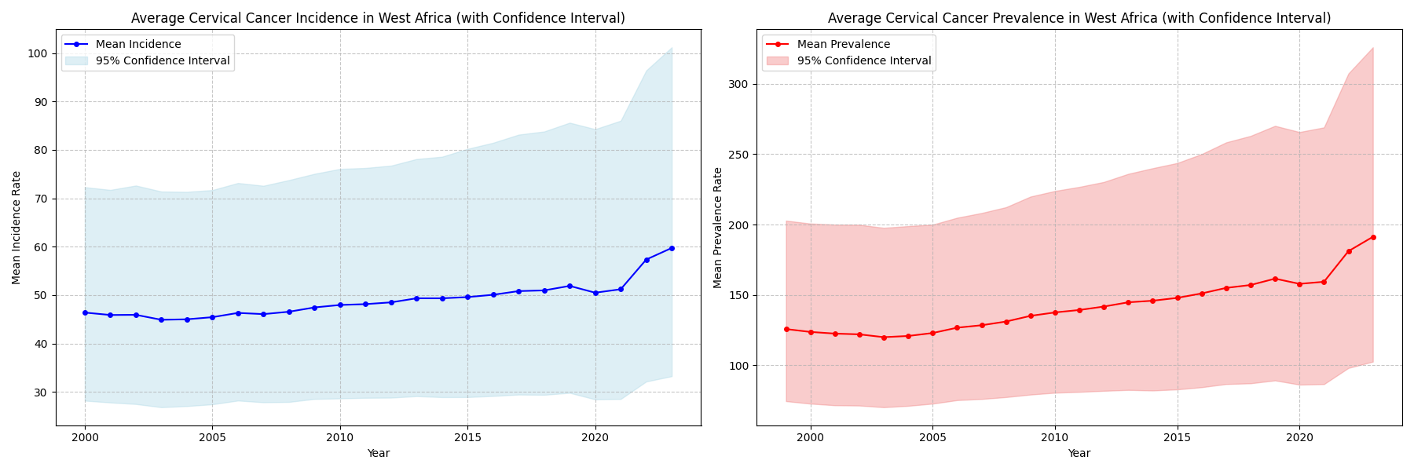
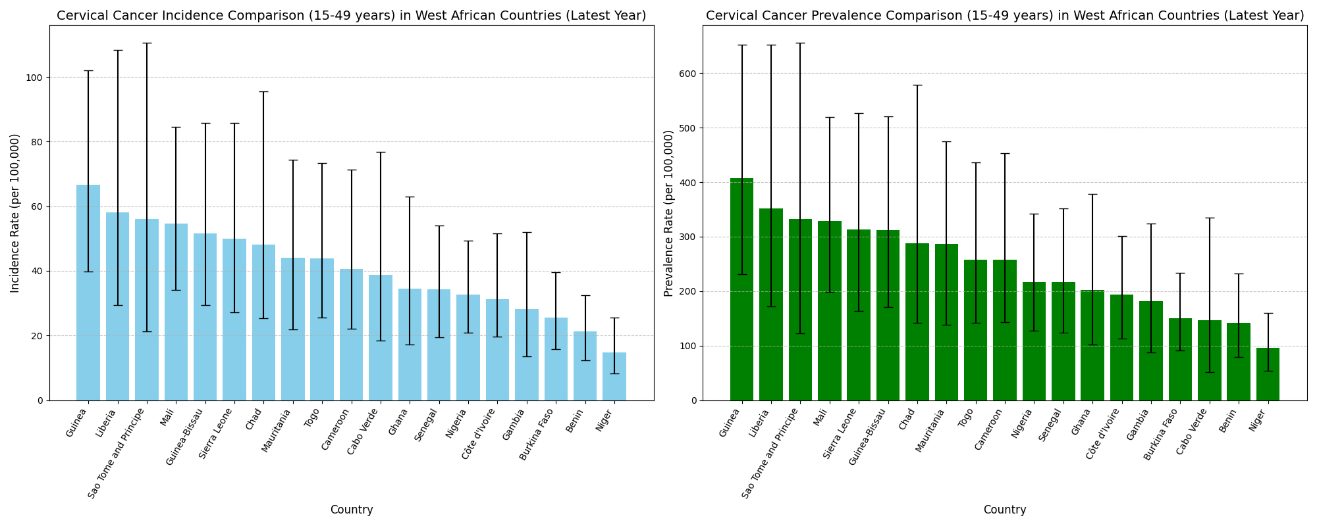
Cervical Cancer Trends in West Africa
Incidence and prevalence vary significantly across West African countries.
Some countries show consistently higher cervical cancer burden.
Wide confidence intervals indicate uncertainty in country-level estimates.
Regional trends show a steady increase in both incidence and prevalence over time.
Sharp rise in recent years suggests a growing public health concern.
Increasing uncertainty in recent data highlights limitations in data quality.
Overall, cervical cancer burden is rising and unevenly distributed across the region.
16

Slide 17
Summary AND CONCLUSION
Cervical cancer burden in West Africa is increasing, with rising incidence and prevalence and clear variation across countries.
Applied Logistic Regression, Random Forest, and XGBoost models to predict cervical cancer risk from lifestyle and clinical features.
Achieved up to 93% accuracy, but recall remained low, meaning many cancer cases were missed.
With hyperparameter tuning, XGBoost produced the best overall result, balancing accuracy and detection.
Accuracy alone is insufficient; recall is critical for effective medical prediction.
17

Slide 18
SUMMARY AND conclusion
Next Steps
Implement additional models (e.g., SVM, Neural Networks, Gradient Boosting variants).
Analyse and report False Positive Rate (FPR) alongside recall.
Further optimise models to improve cancer detection.
Complete write-up and prepare for viva.
CONCLUSION
Cervical cancer remains a growing and unevenly distributed challenge in West Africa, and improving early detection through better data and models is essential.
18

Slide 19
References
Al Mudawi, N., & Alazeb, A. (2022). A Model for Predicting Cervical Cancer Using Machine Learning Algorithms. Sensors (Basel, Switzerland), 22(11), 4132. https://doi.org/10.3390/s22114132
Kaushik, K., Bhardwaj, A., Bharany, S., Alsharabi, N., Rehman, A. U., Eldin, E. T., & Ghamry, N. A. (2022). A Machine Learning-Based Framework for the Prediction of Cervical Cancer Risk in Women.
Mohi Uddin, Khandaker Mohammad & Mamun, Abdullah & Chakrabarti, Anamika & Mostafiz, Rafid & Dey, Samrat. (2024). An ensemble machine learning-based approach to predict cervical cancer using hybrid feature selection. Neuroscience Informatics. 4. 100169. 10.1016/j.neuri.2024.100169.

Slide 20
Thank you for listening

